Slide 1

Decentralized Research Publisher
Transforming scientific publishing with blockchain. Enhancing the transparency, accessibility, and integrity of research. Democratizing knowledge for researchers worldwide.

Slide 2




The Problem: Centralized Research Publishing
High Costs & Paywalls
Limit access to vital research for individuals and institutions.
Opaque Peer Review
Traditional peer review is often slow, biased, and not transparent.
Lack of Incentives
Limited incentives for researchers to openly share their scientific data.

Slide 3

Key Features: Empowering Researchers and Readers
IPFS Integration
Decentralized storage ensures data integrity.
Tokenized Peer Review
Incentivizing quality reviews with tokens.
Crowdfunded Grants
Democratizing research funding.

Slide 4
Architecture & Tech Stack
Blockchain
Ethereum, Ganache
Storage
IPFS, Arweave
Smart Contracts
Solidity
Backend
Flask, Python
Frontend
HTML, CSS, JavaScript

Slide 5




Demo/Walkthrough: Publishing and Reviewing
Submit Paper
Via IPFS.
Initiate Review
Tokenized peer review.
Crowdfund Grant
Fund research.

Slide 6
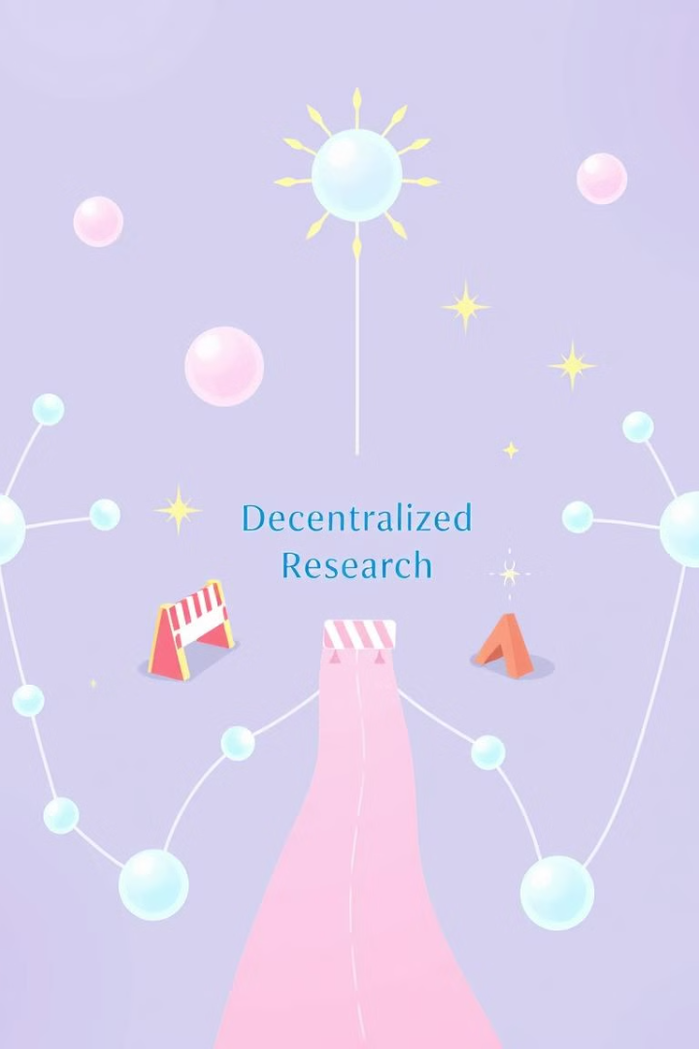
Challenges & Learnings
1
Scalability
2
Server stability
3
Regulatory compliance

Slide 7

Future Roadmap
Global Adoption
Expand platform reach.
Partnerships
Collaborate with key institutions.
Innovation
Add innovative features.

Slide 8



Conclusion
2
Accessibility
1
Transparency
Integrity
3

Slide 9

Thank You
Thanks for your time!

